Slide 1


Tutorial 21: Introduction to Quantum Computing: From Algorithm to Hardware
Hiu-Yung Wong (hiuyung.wong@sjsu.edu)
Electrical Engineering
San Jose State University, CA, USA
13:00-16:30, Sept. 21, 2023

Slide 2
Agenda
Self-introduction
Part I: Overview of Quantum Computing (Lecture)
Part II: Understanding Quantum Gates (Hands-on)
Write your own simulator in Google Co-Lab
Parts III & IV: Deutsch Algorithm and Quantum Fourier Transform (Lecture + Hands-on)
Programming on IBM-Q
Part V: Superconducting Qubit Hardware (Lecture)
Part VI: Optimizing Qubit Readout Using Qiskit and HFSS (Demo)

Slide 3

Resources
Download tutorial files and hands-on materials
https://github.com/hywong2/QCE2023_Tutorial_21

Slide 4




Resources
Book: (2nd Edition with 200+ questions and answers and links to teaching videos)
Introduction to Quantum Computing: From a Layperson to a Programmer in 30 Steps | SpringerLink (https://link.springer.com/book/10.1007/978-3-030-98339-0) (Free if your school has a subscription, connect to VPN)
Introduction to Quantum Computing: From a Layperson to a Programmer in 30 Steps: Wong, Hiu Yung: 9783030983383: Amazon.com: Books (https://www.amazon.com/Introduction-Quantum-Computing-Layperson-Programmer/dp/3030983382 )
Videos (Youtube):
Introduction to Quantum Computing From a Layperson to a Programmer in 30 Steps – YouTube (https://www.youtube.com/playlist?list=PLnK6MrIqGXsJfcBdppW3CKJ858zR8P4eP)
Quantum Computing Hardware and Architecture – YouTube (https://www.youtube.com/playlist?list=PLnK6MrIqGXsL1KShnocSdwNSiKnBodpie)

Slide 5

Self-Introduction
San Jose State University
Quantum Technology Education
“Introduction to Quantum Computing: from a Layperson to a Programmer in 30 Steps”

Slide 6
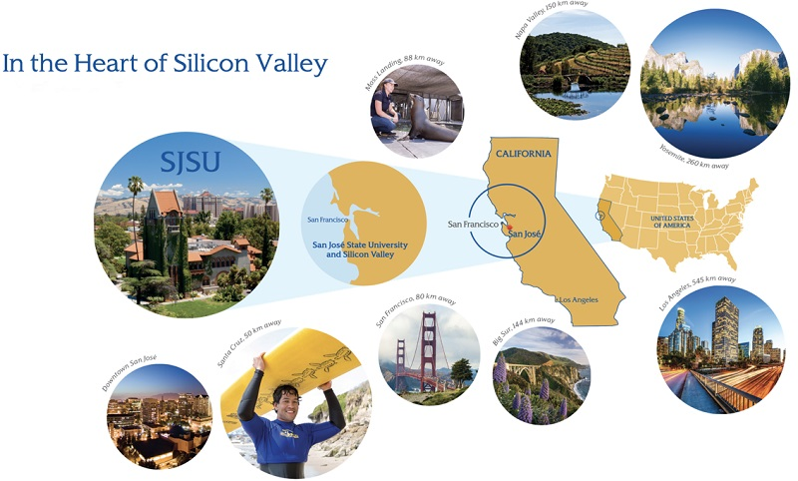
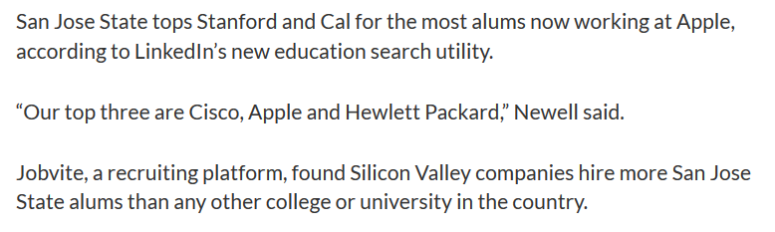
About San Jose State University
36,000 students
Minority Serving Institution (MSI)
Hispanic Serving Institution (HSI)
Electrical Engineering:
~300 master and ~500 undergraduate students

Slide 7
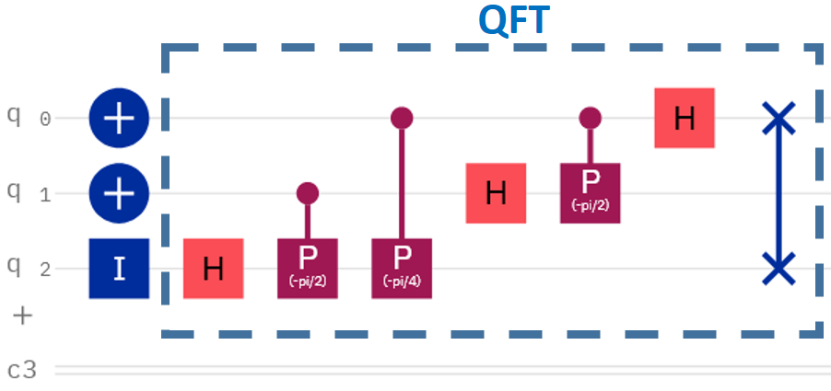
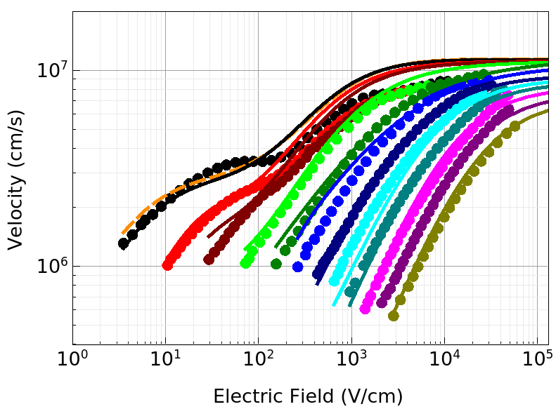
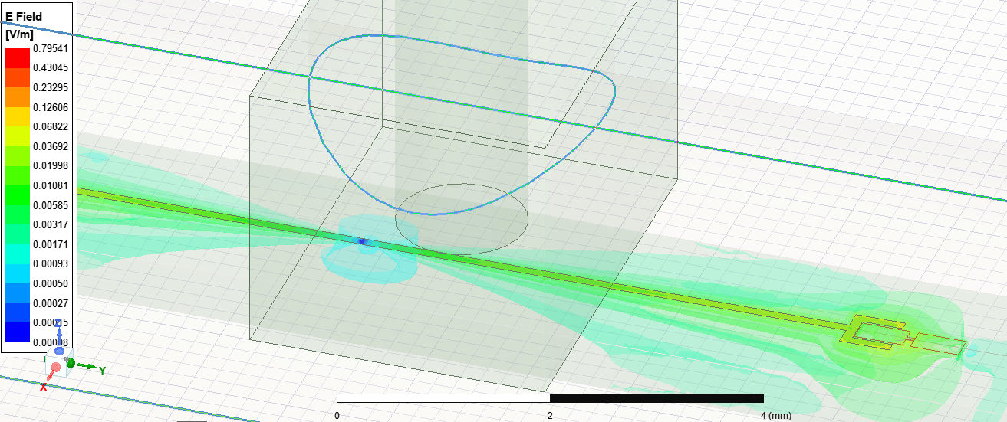
SJSU MSEE Specialization in Quantum Information and Computing
Electrical Engineering, Master of Science
EE225 Introduction to Quantum Computing (Every Fall)
EE226 Cryogenic Nanoelectronics (Spring 22, every 2 years)
EE274 Quantum Computing Architectures (Spring 23, every 2 years)
Python, Qiskit, TCAD, Spectre HFSS, Qiskit Metal

Slide 8

Quantum Technology, Master of Science
The degree promotes flexibility by offering a small set of core knowledge courses in quantum fundamentals along with a range of hardware and software focused electives ... partnerships with industry and national labs … leveraging SJSU’s unique position in Silicon Valley.
MSQT@SJSU:
Started in 2023 Fall
Co-housed in Physics and EE
Core classes
Fundamentals of Quantum Information
Quantum Many-Body Physics
Quantum Computing Architectures
Quantum Programming
NSF Research Traineeship Program (2125906)
Partner with Colorado School of Mines to develop interdisciplinary programs
Partner with LLNL and industry partners for hands-on experience
To learn more: https://www.sjsu.edu/quantum/, Email: quantum@sjsu.edu

Slide 9
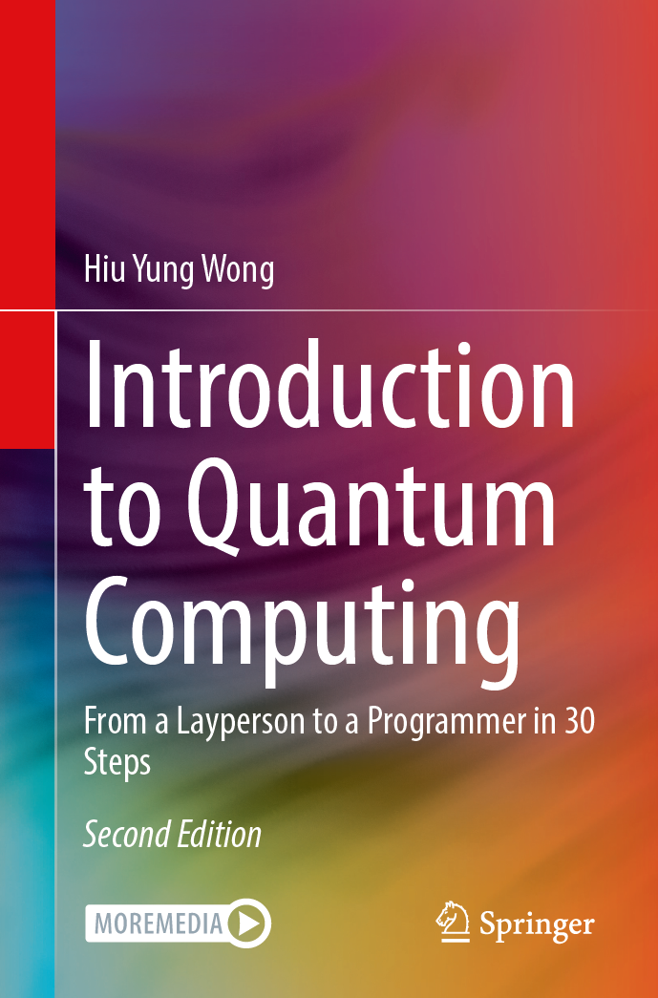



Introduction to Quantum Computing From a Layperson to a Programmer in 30 Steps
Free download with institution subscription to SpringerLink
Available in Amazon Kindle and Nook Book
Introduction to Quantum Computing (EE225)
Quantum Computing Hardware and Architectures (EE274)

Slide 10
Part I: Overview of Quantum Computing (Lecture)
Introduce the fundamental concepts in quantum computing: State, Superposition, Measurement, Entanglement, No-cloning Theorem, Error Correction

Slide 11
Learning Outcomes
Understand the fundamental concepts
Understand the power of quantum parallelism
Understand the importance of superposition, entanglement, measurement, and error correction
Understand that quantum computers cannot replace classical computers but are wonderful accelerators

Slide 12
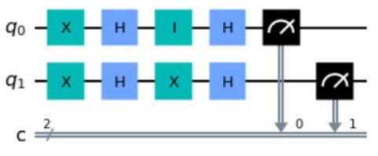
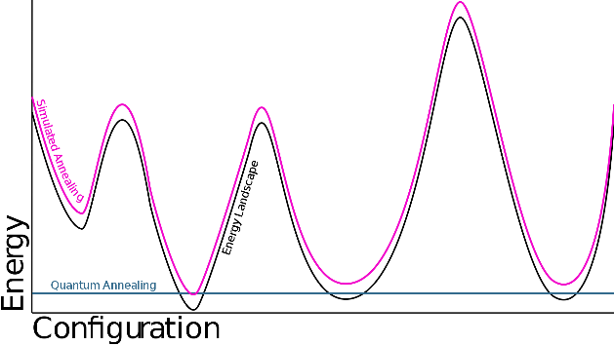
Applications of Quantum Computing
Quantum computing uses two quantum phenomena
Superposition and entanglement and, also, interference
Two major types of quantum computing
Gate-based (this talk)
Quantum annealing (optimization by minimizing energy)
Applications
Material (battery) and drug (pharma) design
Computational Fluid Dynamics
Secure communication
Quantum machine learning
Financial Services and Solutions (e.g. Black Swan Forecasting)
Gate Model
Quantum Annealing

Slide 13
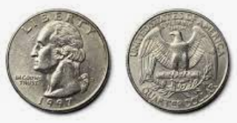
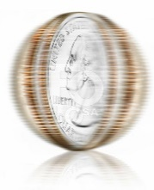



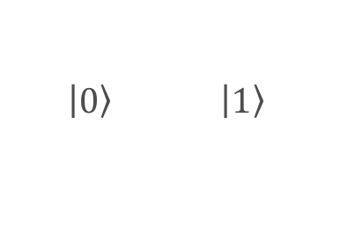


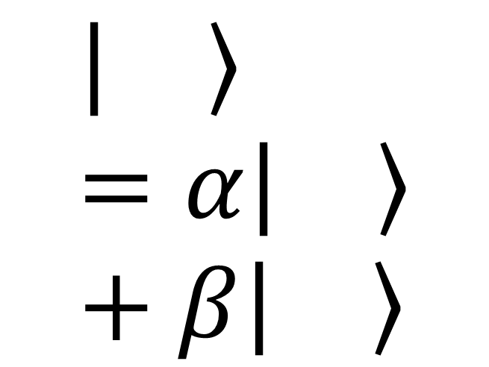



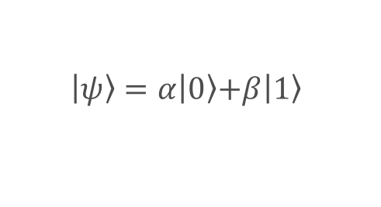
State and Superposition
Classical Computing
Quantum Computing
(basis states)
Quantum Computing with superposition
$$0$$
$$1$$
$\left.\left|0\right.\right\rangle$ $\left.\left|1\right.\right\rangle$
$$\left.\left|ψ\right.\right\rangle =\left.α\left|0\right.\right\rangle \left.+β\left|1\right.\right\rangle$$
$$\left.\left|\right.\right\rangle =α\left.\left|\right.\right\rangle +β\left.\left|\right.\right\rangle$$
Information represented by the states
Quantum computing is powerful because it uses superposition
No difference from classical computing

Slide 14
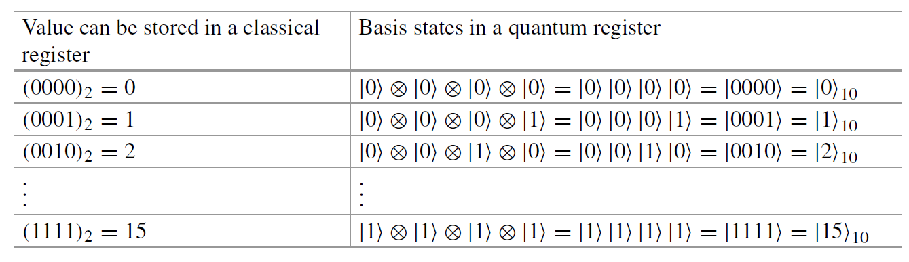
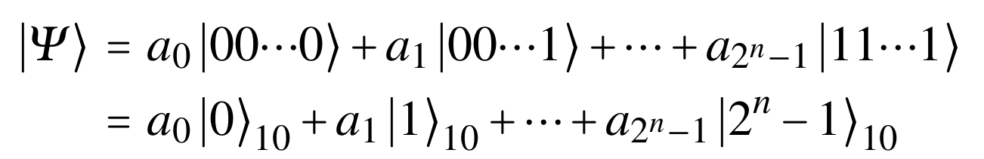
Quantum Registers
Superposition of basis states of multiple qubits

Slide 15
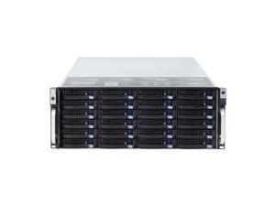
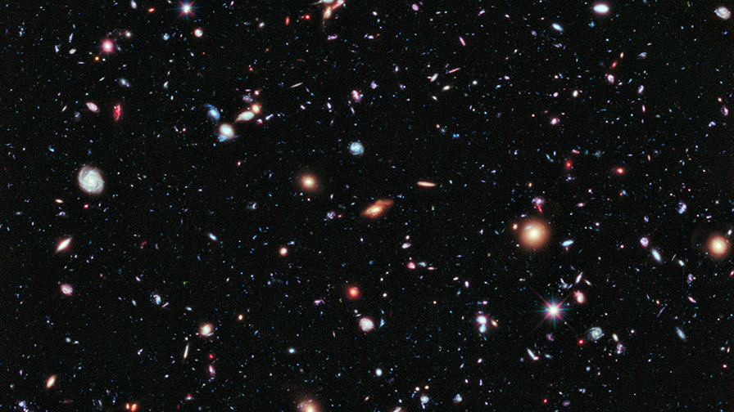
The Power of Superposition
n = 300 (e.g. electrons)
2³⁰⁰ = 10⁹⁰ complex coefficients, a_{i}
Number of atoms in the universe < 10⁸²
Total number of storage in the world < 10²¹ bytes

Slide 16

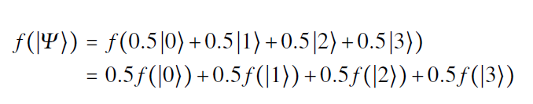
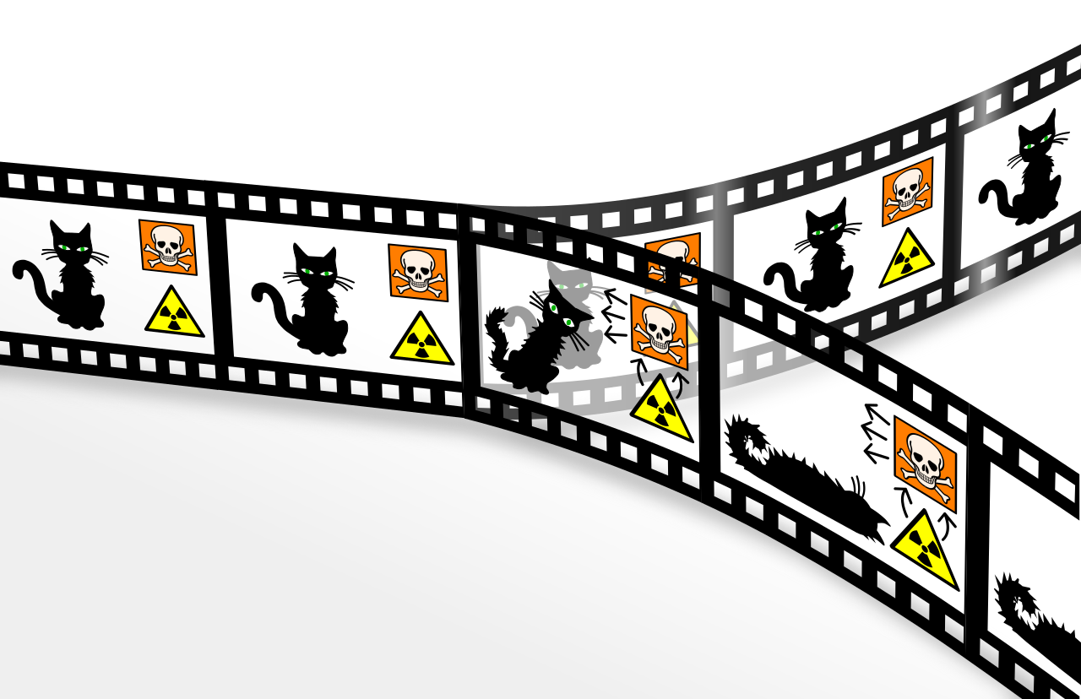

Quantum Parallelism
Linear Quantum mechanics
Wikipedia

Slide 17
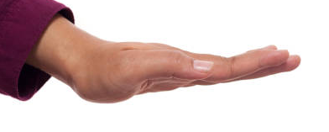
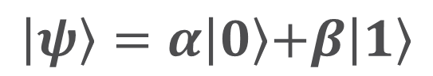


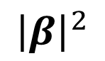
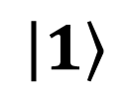

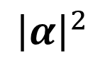
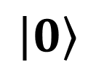
Measurement
$${\left|α\right|}^{2}$$
$$\left.\left|0\right.\right\rangle$$
$$\left.\left|ψ\right.\right\rangle =\left.α\left|0\right.\right\rangle \left.+β\left|1\right.\right\rangle$$
M
$$\left.\left|1\right.\right\rangle$$
$${\left|β\right|}^{2}$$

Slide 18
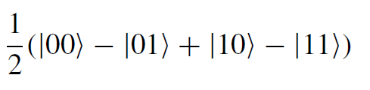
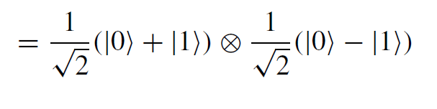
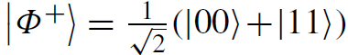

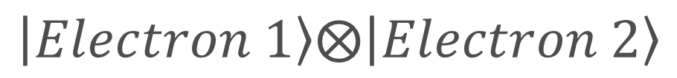
Entangled States
Unentangled State
$$\left.\left|ψ\right.\right\rangle =$$
Electron 1
Electron 2
Entangled State: Used in quantum computing algorithms and also quantum communications
$$\left.\left|Electron 1\right.\right\rangle ⨂\left.\left|Electron 2\right.\right\rangle$$

Slide 19
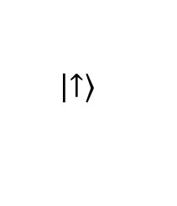
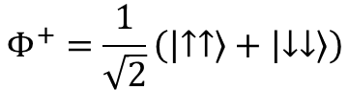
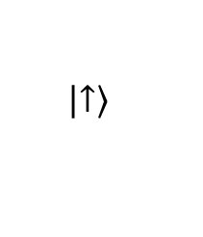
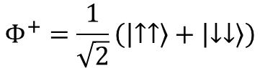
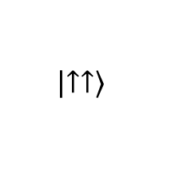
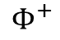
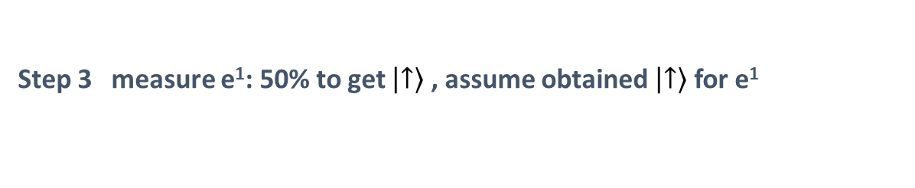
Quantum Entanglement – Spooky Action
$$Φ^{+}=\frac{1}{\sqrt{2}}\left(\left.\left|↑↑\right.\right\rangle +\left.\left|↓↓\right.\right\rangle \right)$$
Step 1
e¹
e²
Step 2
Earth
$$Φ^{+}=\frac{1}{\sqrt{2}}\left(\left.\left|↑↑\right.\right\rangle +\left.\left|↓↓\right.\right\rangle \right)$$
100 light years away
e¹
still entangled
e²
Step 3 measure e¹: 50% to get $\left.\left|↑\right.\right\rangle$ , assume obtained $\left.\left|↑\right.\right\rangle$ for e¹
collapse
$$Φ^{+}$$
$$\left.\left|↑↑\right.\right\rangle$$
$$\left.\left|↑\right.\right\rangle$$
Earth
100 light years away
$$\left.\left|↑\right.\right\rangle$$
e¹
e²

Slide 20
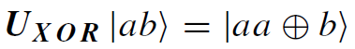
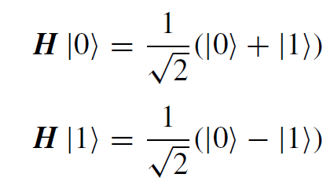
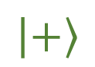
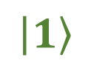
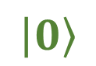
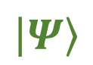


Quantum Gates
Bloch Sphere
Quantum gates rotate the vector (state) in the corresponding hyperspace
Very often, a gate is just a laser or microwave pulse
Some gates have classical counterparts
NOT (X) gate (1-qubit)
XOR (CNOT) gate (2-qubit)
Some gates have no classical counterparts
Hadamard gate (for Superposition)
$$\left|\left.0\right\rangle \right.$$
$$\left|\left.Ψ\right\rangle \right.$$
θ
$$\left|\left.−\right\rangle \right.$$
$$φ$$
$$\left|\left.+\right\rangle \right.$$
$$\left|\left.1\right\rangle \right.$$
We embed the hyperspace of a qubit in our real 3D space

Slide 21
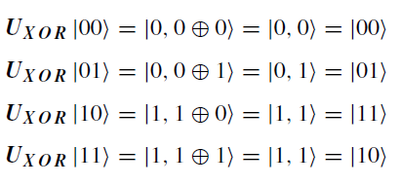
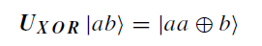

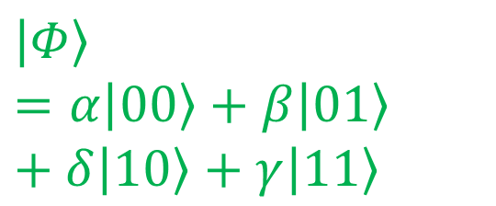
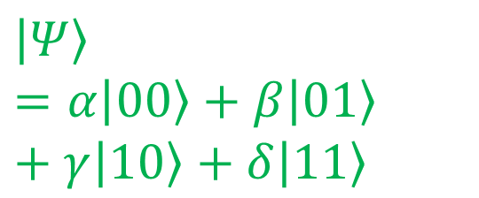
CNOT (XOR) Gate (Entanglement)
Control Qubit
Target Qubit
$$\left|\left.Ψ\right\rangle \right.=α\left|\left.00\right\rangle \right.+β\left|\left.01\right\rangle \right.+γ\left|\left.10\right\rangle \right.+δ\left|\left.11\right\rangle \right.$$
MSB
$$\left|\left.Φ\right\rangle \right.=α\left|\left.00\right\rangle \right.+β\left|\left.01\right\rangle \right.+δ\left|\left.10\right\rangle \right.+γ\left|\left.11\right\rangle \right.$$
$$⨁$$
LSB

Slide 22
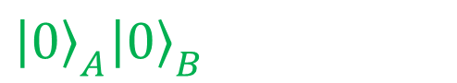
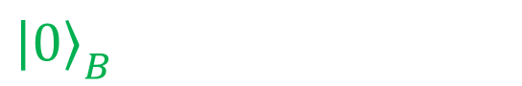


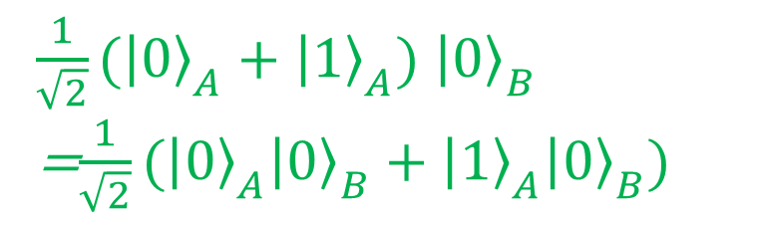
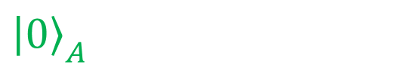

Entanglement Example
MSB
$$H$$
$${\left|\left.0\right\rangle \right.}_{A}$$
$${\left|\left.0\right\rangle \right.}_{A}{\left|\left.0\right\rangle \right.}_{B}$$
$\frac{1}{\sqrt{2}}({\left|\left.0\right\rangle \right.}_{A}+{\left|\left.1\right\rangle \right.}_{A})$ ${\left|\left.0\right\rangle \right.}_{B}$
=$\frac{1}{\sqrt{2}}({\left|\left.0\right\rangle \right.}_{A}{\left|\left.0\right\rangle \right.}_{B}+{\left|\left.1\right\rangle \right.}_{A}{\left|\left.0\right\rangle \right.}_{B})$
$$\frac{1}{\sqrt{2}}({\left|\left.0\right\rangle \right.}_{A}{\left|\left.0\right\rangle \right.}_{B}+{\left|\left.1\right\rangle \right.}_{A}{\left|\left.1\right\rangle \right.}_{B})$$
$${\left|\left.0\right\rangle \right.}_{B}$$
$$⨁$$
LSB

Slide 23


Quantum Gates and Circuits
Quantum gates must be reversible
Quantum circuit is the application of operations (microwave/laser pulses) to usually stationary qubit carriers.

Slide 24



Error Correction
No-Cloning Theorem: It is not allowed to copy an arbitrary state in quantum mechanics
Syndrome measurement is used for error correction
Classical Error Correction
Quantum Error Correction
$$0⇒000$$
$$1⇒111$$
E.g. Through entanglement and syndrome measurement

Slide 25












Error Correction: Bit Flip Code Example
Qubit to transmit: $\left.\left|Ψ\right.\right\rangle =\left.α\left|0\right.\right\rangle \left.+β\left|1\right.\right\rangle$
1st bit flipped
$$\left.α\left|1\right.00\right\rangle \left.+β\left|011\right.\right\rangle$$
$$\left.α\left|1\right.11\right\rangle \left.+β\left|011\right.\right\rangle$$
$$\left.α\left|0\right.00\right\rangle \left.+β\left|100\right.\right\rangle$$
$$\left.α\left|0\right.00\right\rangle \left.+β\left|111\right.\right\rangle$$
$$\left.α\left|0\right.11\right\rangle \left.+β\left|111\right.\right\rangle$$
Flip one bit due to noise
2nd bit flipped$:\left.α\left|0\right.10\right\rangle \left.+β\left|101\right.\right\rangle$
$$\left.α\left|0\right.10\right\rangle \left.+β\left|110\right.\right\rangle$$
$$\left.α\left|0\right.10\right\rangle \left.+β\left|110\right.\right\rangle$$
$$\text{3}\text{rd} \text{bit} \text{flipped} :\left.α\left|0\right.01\right\rangle \left.+β\left|110\right.\right\rangle$$
$$\left.α\left|0\right.01\right\rangle \left.+β\left|101\right.\right\rangle$$
$$\left.α\left|0\right.01\right\rangle \left.+β\left|101\right.\right\rangle$$

Slide 26
Part II: Understanding Quantum Gates (Hands-on)
Use Google Co-lab to write a quantum gate simulator in python

Slide 27
Learning Outcomes
Understand the operations of the following quantum gates
NOT
CNOT
Hadamard
Phase Shift
Z
iSwap
Understand the importance of entanglement gates
Able to code a simple quantum computer simulator based on the template
Understand Tensor Product and Entanglement

Slide 28














NOT (X) Gate
A gate is defined by how it transforms the basis vectors
Definition
General state
NOT gate is Unitary

Slide 29



Construction of 2 qubit gate using Tensor Product

Slide 30
NOT (X) Gate
Let’s use Google Co-lab to construct 1-qubit and 2-qubit NOT gates
Also create a 2-qubit NOT gate using tensor product

Slide 31




XOR (CNOT) Gate (2-qubit)
Definition
Control Qubit
Target Qubit

Slide 32
XOR (CNOT) Gate (2-qubit)
Let’s use Google Co-lab a CNOT Gate

Slide 33



Walsh-Hadamad (Hadamad) Gate
No classical Counter-Part – create super-position (previous gates only change one basis to another)

Slide 34

Walsh-Hadamad (Hadamad) Gate
Another view
Let’s program on Google Co-lab

Slide 35
Create an Entanglement Circuit Using Your Simulator!
MSB
$$H$$
$${\left|\left.0\right\rangle \right.}_{A}$$
$${\left|\left.0\right\rangle \right.}_{A}{\left|\left.0\right\rangle \right.}_{B}$$
$\frac{1}{\sqrt{2}}({\left|\left.0\right\rangle \right.}_{A}+{\left|\left.1\right\rangle \right.}_{A})$ ${\left|\left.0\right\rangle \right.}_{B}$
=$\frac{1}{\sqrt{2}}({\left|\left.0\right\rangle \right.}_{A}{\left|\left.0\right\rangle \right.}_{B}+{\left|\left.1\right\rangle \right.}_{A}{\left|\left.0\right\rangle \right.}_{B})$
$$\frac{1}{\sqrt{2}}({\left|\left.0\right\rangle \right.}_{A}{\left|\left.0\right\rangle \right.}_{B}+{\left|\left.1\right\rangle \right.}_{A}{\left|\left.1\right\rangle \right.}_{B})$$
$${\left|\left.0\right\rangle \right.}_{B}$$
$$⨁$$
LSB

Slide 36





1-Bit Phase Shift Gate and Z-Gate
Definition
And this is just the σz matrix, one of the important Pauli matrices. And it is also called the Z-gate.

Slide 37




Exchange (SWAP) Gate
Definition

Slide 38
Parts III: Deutsch Algorithm (Lecture + Hands-on)
Deutsch Algorithm
Use the Deutsch algorithm to demonstrate the important concepts in quantum computing with IBM quantum composer
Use scripting (IBM Quantum Lab) to run quantum algorithms

Slide 39
Learning Outcomes
Understand the concept of Quantum Oracle and its implementation
Able to use IBM Composer
Appreciate the meaning of quantum parallelism
Able to program in IBM-Q Quantum Lab with the given circuit

Slide 40


Deutsch’s Problem
Finding if a Boolean function is balanced or constant.
Boolean function:
f : {0, 1} → {0, 1}
constant
balanced
balanced
constant
Classically, 2 computations, f(0) and f(1)
Quantum Computing: 1 computation
Learn the details

Slide 41



Quantum Oracle
Create a Quantum Oracle (Encode the Problem)
Example:

Slide 42







Deutsch Algorithm
Quantum Oracle:
$$U_{f}\left(|\left.x\right\rangle |\left.y\right\rangle \right)=|\left.x\right\rangle |\left.y⊕f\left(x\right)\right\rangle$$
Prepare Initial State:
$$|\left.ψ\right\rangle =\frac{1}{\sqrt{2}}\left(|\left.0\right\rangle +|\left.1\right\rangle \right)⊗\frac{1}{\sqrt{2}}\left(|\left.0\right\rangle −|\left.1\right\rangle \right)=|\left.+\right\rangle ⊗|\left.−\right\rangle$$
Operation (parallelism):
$$U_{f}|\left.ψ\right\rangle$$
Operation (prepare to measurement in $\left.\left|+\right.\right\rangle \left.\left|−\right.\right\rangle$Basis
$${(H⊗I_{2})U}_{f}|\left.ψ\right\rangle$$
Measurement 1st bit: If $|\left.0\right\rangle$, constant; If $|\left.1\right\rangle$, balanced;

Slide 43





Parallel Operation in Deutsch Algorithm
$f\left(0\right) and f\left(1\right)$ are evaluated at the same time!
If balanced, $\left.\left|+\right.\right\rangle$ becomes $\left.\left|−\right.\right\rangle$ in MSB
If constant, $\left.\left|+\right.\right\rangle$ is still $\left.\left|+\right.\right\rangle$ in MSB

Slide 44





Live Demonstration on IBM-Q
Simulation
Real Computer
Step 1
Step 2
Step 3
$$U_{f}\left(|\left.x\right\rangle |\left.y\right\rangle \right)=|\left.x\right\rangle |\left.y⊕f\left(x\right)\right\rangle$$
https://youtu.be/owUnw9MwJlg?t=466

Slide 45
Run Deutsch Algorithm on IBM-Q using Scripting
You can either run on
Quantum Lab
Or local Jupyter Notebook or Google Co-lab

Slide 46
Parts IV: Quantum Fourier Transform (Lecture + Hands-on)
Have a deeper understand of destructive and constructive interferences to extract information

Slide 47
Learning Outcomes
Appreciate the similarity between Fast Fourier Transform and QFT
Appreciate the complexity of quantum circuits with many qubits
Understand better the meaning of constructive and destructive interference

Slide 48






N-th Root of Unity

Slide 49








Properties of the N-th Root of Unity
1)
destructive interference
2)
3)
constructive interference
Many algorithms use this property to extract useful information through interferences (by using QFT).

Slide 50







Discrete Fourier Transform

Slide 51


Quantum Fourier Transform
In some literature, this is called Inverse QFT.
Unlike in electrical engineering, we are not transforming between time and frequency basis. QFT is transforming within the same basis.

Slide 52



1-qubit and 2-qubit QFT
2-qubit matrix
This is just a 1-qubit Hadamard gate.

Slide 53
Implementation of n-qubit QFT
Let’s implement an n-qubit QFT in our quantum computer simulator

Slide 54
Part V: Superconducting Qubit Hardware (Lecture)
Use superconducting qubits as an example to show how initialization, readout, 1-qubit, and 2-qubit gates are possible

Slide 55



Role of Engineers in QC – My perspective
Semiconductor:
Physicist
Engineer
Scattering based on Fermi Golden Rule and Bloch Function (David Esseni, “Nanoscale MOS Transistors“)
TCAD Analytical Equation (Synopsys, Silvaco)
Priceless
$100M/year
Quantum Computer:
$$$
Jaynes-Cummings Hamiltonian
(Blais et al, PHYSICAL REVIEW A 69, 062320 (2004))
Analytical Equation (Your names, your companies)

Slide 56






There is plenty of room in the (eco-)System
High Speed Circuit, Programming
OPX Quantum Machines
Algorithm
Amplifier
+40dB
Microwave Engineering
300K
-20dB
HEMT
+40dB
Education
4K
-20dB
Cryogenic Electronics
700mK
Vacuum and cryogenic technologies
-20dB
Isolator
10mK
Circulator
TWPA
+20dB
Qubit Physics

Slide 57
DiVincenzo’s Criteria
5 Necessary Criteria for quantum computing:
A scalable physical system with well-characterized qubit (system needs to remain in the 2-level subspace)
The ability to initialize the state of the qubits to a simple fiducial state (initialization time is important)
Long relevant decoherence times (much longer than gate time)
A "universal" set of quantum gates (1-qubit gates + entanglement gate)
A qubit-specific measurement capability (Some algorithms only work without measuring all qubits at the same time e.g. teleportation)
2 Necessary Criteria for quantum communication:
The ability to interconvert stationary and flying qubits (even with one bit stationary and one bit flying)
The ability to faithfully transmit flying qubits between specified locations (without decoherence)

Slide 58











Implementations of Qubits
$$\left.\left|Mood\right.\right\rangle =α\left.\left|\right.\right\rangle +β\left.\left|\right.\right\rangle$$
Not a reliable qubit
Electron Spin Qubit
Photonic Qubit
Superconducting Charge Qubit
$$path1$$
$$n$$
$path$0
$$\left.\left|\right.\right\rangle =α\left.\left|\right.\right\rangle +β\left.\left|\right.\right\rangle$$
$$\left.\left|ψ\right.\right\rangle =α\left.\left|path0\right.\right\rangle +β\left.\left|path1\right.\right\rangle$$
$$\left.\left|ψ\right.\right\rangle =α\left.\left|n=0\right.\right\rangle +β\left.\left|n=1\right.\right\rangle$$
Physics Today 72, 8, 38 (2019)
Scientific Reports 3, 1394 (2013)
Wikipedia

Slide 59




Noise, De-coherence Time and Energy Scale
Qubit loses its state due to noise
Need ultra-low temperature to avoid thermal noise (DR, laser cooling)
Decoherence time:
T₁:$\left.\left|1\right.\right\rangle ⇒\left.\left|0\right.\right\rangle$
T₂:$\left.\left|0\right.\right\rangle +\left.\left|1\right.\right\rangle ⇒?\left.\left|0\right.\right\rangle ?\left.\left|1\right.\right\rangle$
Qubit energy separation
Liquid-He
Dilution Fridge
Liquid-N

Slide 60






Why not LC Tank?
Blais et al, Review of Modern Physics (2021)
Lack of anharmonicity
Generalized momentum: Q
Generalized Coordinate: $Φ$
Charge qubit
Transmon qubit when E_{C}<<E_{J} (less sensitive to charge noise, $n_{g}$)

Slide 61




Josephson Junction
Wiki
Josephson Equations
Nonlinear Inductance
Superconductor
Al
Superconductor
Al
Insulator
(Al₂O₃)
Josephson Energy

Slide 62


System Overview
2X: Initialization
and 1-qubit gate
OPX Quantum Machines
Readout
Amplifier
+40dB
300K
-20dB
HEMT
+40dB
4K
-20dB
700mK
-20dB
Isolator
10mK
Circulator
Resonator & Qubit
TWPA
+20dB
A. Place, et al., Nat. Comm 12, 1779 (2021)

Slide 63







Signal Amplification and Noise
Friis’ Equation
Reminder:
$$P(dB)=10\log_{10}{\frac{P(W) }{1W}}$$
$$P(dBm)=10\log_{10}{\frac{P(W)}{1mW}}$$
$$G(dB)=20\log_{10}{G}$$
Numerical Example:

Slide 64
































Parametric Amplifier
$$\overset{⃑}{E}$$
$$\overset{⃑}{E}$$
$$0$$
$$0$$
$$0$$
$$0$$
$$0$$
$$0$$
$$0$$
$$+Q$$
$$−Q$$
$$+Q$$
$$−Q$$
$$0$$
Energy added
$$d+∆d$$
No energy retrieved
$$d$$
Repeat 2 times every cycle
$$d$$
$$d+∆d$$
$$d+∆d$$
$$V_{c}$$
$$V_{c}$$
$$V_{c}$$
$$V_{c}$$
$$V_{c}$$
$$E=\frac{Q^{2}}{2C},C=\frac{ε}{d}$$
$$E=\frac{Q^{2}}{2C}=0$$
$$E=\frac{Q^{2}}{2C}=0$$
$$E=\frac{Q^{2}}{2C},C=\frac{ε}{d+∆d}$$
$$E=\frac{Q^{2}}{2C}=0$$

Slide 65


Traveling Wave Parametric Amplifier
Add minimum noise to the signal (Quantum Limited Amplifier)
Noise source: Uncertainty Principle
C. Macklin et al., “A near–quantum-limited Josephson traveling-wave parametric amplifier”, Science, 2015

Slide 66




Discrete Cryo HEMT LNA
1st stage: Input matching and low noise
3rd stage: Gain flatness and output match

Slide 67







I-Q Mixers
$$A\cos\left(2πft+φ\right)$$
$=A\cos\left(2πft\right)\cos\left(φ\right)$-$A\sin\left(2πft\right)\sin\left(φ\right)$
$=A\cos\left(φ\right)\cos\left(2πft\right)$-$A\sin\left(φ\right)\sin\left(2πft\right)$
$=I\cos\left(2πft\right)$-$Q\sin\left(2πft\right)$
46MHz (If_res)
46MHz (If_res)
$$ω_{LO}−ω_{IF}$$
$$ω_{LO}+ω_{IF}$$
1 qubit gate: to be discussed later
Single-side band mixer
Enabled by proper engineering of the I/Q signal
7.2GHz (lo_res)
$$H=−\frac{∆}{2}σ_{z}+\frac{Ω_{R}}{2}\left(\cos{φ}σ_{x}+{\sin{φ}σ}_{y}\right)$$
$$∆=ω_{01}−\left(ω_{LO}+ω_{IF}\right)$$
$$Ω_{R}\sim A$$
https://www.markimicrowave.com/blog/the-why-and-when-of-iq-mixers-for-beginners/

Slide 68



Cavity QED
$ω_{r}$: Cavity resonant frequency
$Ω$: Atom transition frequency
g: atom-photon coupling strength
$Δ$: detuning ($Ω$-$ω_{r}$)
uncoupled
uncoupled
dressed
(Blais et al, PHYSICAL REVIEW A 69, 062320 (2004))

Slide 69













Circuit QED
Resonator as Cavity
Cooper Pair Box: Artificial Atom
$$\left.\left|0\right.\right\rangle$$
$$\left.\left|1\right.\right\rangle$$
$${\left.\left|1\right.\right\rangle }_{ph}{\left.\left|0\right.\right\rangle }_{charge}$$
$$ω_{r}−\frac{g^{2}}{Δ}$$
$${\left.\left|0\right.\right\rangle }_{ph}{\left.\left|0\right.\right\rangle }_{charge}$$
$$Ω+\frac{2g^{2}}{Δ}$$
Suppressed
Apply a pulse
$${\left.\left|0\right.\right\rangle }_{ph}{\left.\left|1\right.\right\rangle }_{charge}$$
$${\left.\left|1\right.\right\rangle }_{ph}{\left.\left|2\right.\right\rangle }_{charge}$$
$$ω_{r}−Δ−\frac{3g^{2}}{Δ}$$
Suppressed
$${\left.\left|0\right.\right\rangle }_{ph}{\left.\left|1\right.\right\rangle }_{charge}$$
$$ω_{r}+\frac{g^{2}}{Δ}$$
(Blais et al, PHYSICAL REVIEW A 69, 062320 (2004))
$${\left.\left|1\right.\right\rangle }_{ph}{\left.\left|1\right.\right\rangle }_{charge}$$

Slide 70




Cross Kerr
Cross-Kerr, $χ=\frac{g^{2}}{Δ}$, signifies how much the cavity resonant frequency is “pulled”. This is only valid with large E_{C}/ħ>>Δ (but charging energy usually is smaller than detuning).
More accurate one:
$$\left.\left|0\right.\right\rangle$$
$$\left.\left|1\right.\right\rangle$$
(Blais et al, PHYSICAL REVIEW A 69, 062320 (2004))

Slide 71








Scattering Matrix
$$V_{1}^{+}$$
$$V_{1}^{−}$$
$$\frac{V_{1}^{−}}{V_{1}^{+}}$$
$$\left.\left|0\right.\right\rangle$$
$$\left.\left|1\right.\right\rangle$$
Pozar’s Book
Phys. Rev. A 69, 062320 (2004)

Slide 72


Scattering Matrix
$$2χ$$

Slide 73



Distinguishing $\left.\left|0\right.\right\rangle$ and $\left.\left|1\right.\right\rangle$
After transformation
Hiu Yung Wong et al., "A Simulation Methodology for Superconducting Qubit Readout Fidelity," SSE, 2023.

Slide 74







IQ Signal for Reading
Si QDOT qubit reading
$$A\cos\left(2πft+φ\right)$$
$=A\cos\left(2πft\right)\cos\left(φ\right)$-$A\sin\left(2πft\right)\sin\left(φ\right)$
$=A\cos\left(φ\right)\cos\left(2πft\right)$-$A\sin\left(φ\right)\sin\left(2πft\right)$
$=I\cos\left(2πft\right)$-$Q\sin\left(2πft\right)$
$$\tan\left(φ\right)=−\frac{Q}{I}$$
$$Q$$
$$\left.\left|0\right.\right\rangle$$
$$I$$
$$\left.\left|1\right.\right\rangle$$
IEEE JSSC, vol. 56, no. 7, pp. 2040-2053, July 2021

Slide 75


Single Qubit Gate

Slide 76






Implementation of Single Qubit Gates
Superconducting Charge Qubit
$$H=\frac{1}{2}\left(\begin{matrix}−E & −E_{J} \\ −E_{J} & E\end{matrix}\right)=−\frac{1}{2}\vec{σ}∙\vec{B}$$
$\vec{B}=\left(\begin{matrix}E_{J} \\ 0 \\ E\end{matrix}\right)$ ${E=E}_{c}(1−2n_{g})$
$$n$$
Make U time varying so that $n_{g}=\frac{1}{2}−η\cos{(ω_{1}t+φ)}$
Rotating frame approximation (set $ℏ=1$)
$$\left.\left|ψ\right.\right\rangle =α\left.\left|n=0\right.\right\rangle +β\left.\left|n=1\right.\right\rangle$$
$$H=−\frac{Δ}{2}σ_{z}+\frac{Ω}{2}{(\cos\left(φ\right)σ}_{x}+{\sin{(φ)}σ}_{y})$$
Wikipedia
Depends on $ω_{1}$, E_{J} and E_{C}
Phase of the driving pulse
Depends on $η$and E_{C}

Slide 77


Single Qubit Gate (e.g. X and H Gates)
Different frequencies of the microwave pulse cause the rotation about different axes in the x-z plane.

Slide 78



iSWAP Gate – 2-qubit gate
iSWAP Gate for entanglement operation
J. C. Bardin, D. Sank, O. Naaman and E. Jeffrey, "Quantum Computing: An Introduction for Microwave Engineers," in IEEE Microwave Magazine, vol. 21, no. 8, pp. 24-44, Aug. 2020.

Slide 79

Is Quantum Computing Omnipotent?
Each state contains a profound amount of information, but we cannot extract them with reasonable resources. How do we get the a’s?
QC is suitable for answering questions that classical computers cannot answer well. Often, destructive and constructive interferences are used to obtain the answers.
E.g. Is the function balanced? What is the period of the function?
QC cannot replace classical computers but can be a very powerful accelerator for difficult problems, e.g. optimization problems.

Slide 80
Part VI: Optimizing Qubit Readout Using HFSS with Qiskit Metal (Demo)
Show how to combine Qiskit Metal and HFSS to design the circuit of a quantum qubit in terms of Energy Participation Ratio

Slide 81
Learning Outcomes and Materials
Appreciate the role of high-speed electronics, microwave electronics, and cryogenic electronics in quantum computer
See the last 10 videos (Lab 1 to Lab 10) for installation instructions
https://www.youtube.com/playlist?list=PLnK6MrIqGXsL1KShnocSdwNSiKnBodpie

Slide 82





Energy Participation Ratio
Reduced the quantization problem to “what fraction of the energy mode m is stored in element j?
Energy participation ratio: p_{mj}
Use eigenmode simulation in HFSS
Goal:
Get $ω_{c}$, $ω_{q}$ from eigenmode analysis
Get $φ_{c}$, $φ_{q}$ (zero point fluctuations) from EPR

Slide 83






Energy Participation Ratio
Can be computed from E and H field at mode m
P_{m} is between 0 and 1
Get anharmonicity
χqc is the qubit–cavity dispersive shift (cross-Kerr coupling).

Slide 84
Steps to Install and Run Qiskit Metal
Lab 1) How to Install Ansys HFSS
https://www.youtube.com/watch?v=eBUAmox45hk&list=PLnK6MrIqGXsL1KShnocSdwNSiKnBodpie&index=76
Lab 2) How to install Anaconda on Windows
https://www.youtube.com/watch?v=ncftLDI8Mv8&list=PLnK6MrIqGXsL1KShnocSdwNSiKnBodpie&index=77
Lab 3) How to Install Qiskit Metal and Run a Simple Example
https://www.youtube.com/watch?v=hs0tzZpH0xQ&list=PLnK6MrIqGXsL1KShnocSdwNSiKnBodpie&index=78
If you have error, see “Lab 4) Possible Errors when Installing Qiskit Metal”
https://www.youtube.com/watch?v=rLAH1RZHgtM&list=PLnK6MrIqGXsL1KShnocSdwNSiKnBodpie&index=79

Slide 85
Overview of Qiskit Metal (Hands-on)
I called my environment “qmetal”
conda activate qmetal
jupyter notebook
http://localhost:8888/tree/Dropbox/SJSU/SJSU/Research/Presentations/QCE2023/Final%20Materials/Project_Test
Copy from:
https://pypi.org/project/qiskit-metal/
See Lab 3 example

Slide 86
Interaction between Qiskit Metal and HFSS (Hands-on + Demo)
Go to
https://qiskit.org/ecosystem/metal/tut/4-Analysis/4.02-Eigenmode-and-EPR.html
Or directly download:
https://github.com/qiskit-community/qiskit-metal/blob/main/docs/tut/4-Analysis/4.02-Eigenmode-and-EPR.ipynb
Understand
JJ mode
Cavity mode
EPR
Cross-Kerr

Slide 87
Analysis of an Existing HFSS Structure
If you do not want to create the structure through qiskit metal, or if it is not supported (e.g. a 3D structure), you can also control HFSS through the qiskit metal library.
Lab 7) Creating a 3D Cavity with Ports using HFSS
https://www.youtube.com/watch?v=sxgso3MG7lU&list=PLnK6MrIqGXsL1KShnocSdwNSiKnBodpie&index=82
Lab 8) Create Transmon Qubit on Sapphire substrate in the 3D Cavity using HFSS
https://www.youtube.com/watch?v=hRjvxroiQ-k&list=PLnK6MrIqGXsL1KShnocSdwNSiKnBodpie&index=83
Lab 9) Finding the cross-Kerr of Transmon qubit in a 3D Cavity using pyEPR in Qiskit Metal
https://www.youtube.com/watch?v=vCCVgfFAFwo&list=PLnK6MrIqGXsL1KShnocSdwNSiKnBodpie&index=84

Slide 88
Recap
Part I: Overview of Quantum Computing (Lecture)
Part II: Understanding Quantum Gates (Hands-on)
Write your own simulator in Google Co-Lab
Parts III & IV: Deutsch Algorithm and Quantum Fourier Transform (Lecture + Hands-on)
Programming on IBM-Q
Part V: Superconducting Qubit Hardware (Lecture)
Part VI: Optimizing Qubit Readout Using HFSS and Qiskit (Demo)

Slide 89
How to study in a short time?
N. David Mermin:
Shut up and Calculate!

Slide 90
Introduction to Quantum Computing From a Layperson to a Programmer in 30 Steps (2nd Edition with 200+ questions and answers and links to teaching videos)
Free download with institution subscription to SpringerLink
Available in Amazon Kindle and Nook Book
Introduction to Quantum Computing (EE225)
Quantum Computing Hardware and Architectures (EE274)

